Slide 1
SharePoint Framework M5 & M6
Jenkins NS
@jenkinsns

Slide 2

Agenda
Module 5: SharePoint Framework Client Web Parts
What is a Client Web Part?
Creating a project
Exploring Project Contents
Running Your Project
Gulp tasks

Slide 3
What is a Client Web Part?
Client-side web parts are client-side components that run in the context of a SharePoint page. Client-side web parts can be deployed to SharePoint environments that support the SharePoint Framework. You can also use modern JavaScript web frameworks, tools, and libraries to build them.
Client-side web parts support:
Building with HTML and JavaScript.
Both SharePoint Online and on-premises environments.

Slide 4
Creating a SPFx Project
To begin with the development, just make sure that you have the latest node,yeoman, gulp and yeoman SharePoint generator are installed in your machine. These are needed to ensure your machine’s suitability for the development of SharePoint framework offered by Microsoft.

Slide 5
Node_modules, Package.json
Any SharePoint Framework (SPFx) solution that does something useful will use external JavaScript libraries – whether bigger frameworks such as React or Angular, or smaller, more focused libraries such as LoDash, moment.js or something else.
SPFx is based on a node.js-based web stack, the best way to integrate such libraries into your solution is usually to add them from npm, the internet-based package manager for JavaScript.
Npm is effectively an equivalent of NuGet in the .NET world. Once you’re set up with npm, a developer simply runs npm install jquery [or whatever] and the source code for the package will be added to your application’s files.
As is normal with node development, the library is added under the “node_modules” subfolder, and it can now be referenced in your code.

Slide 6
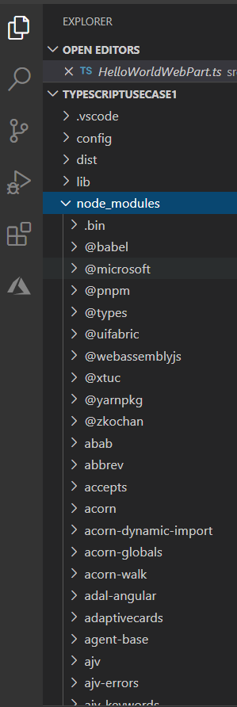
The role of the node_modules folder
The node_modules folder stores all your dependencies. So, it’s a tree structure which can be quite deep. An app which uses jQuery and React for example.

Slide 7
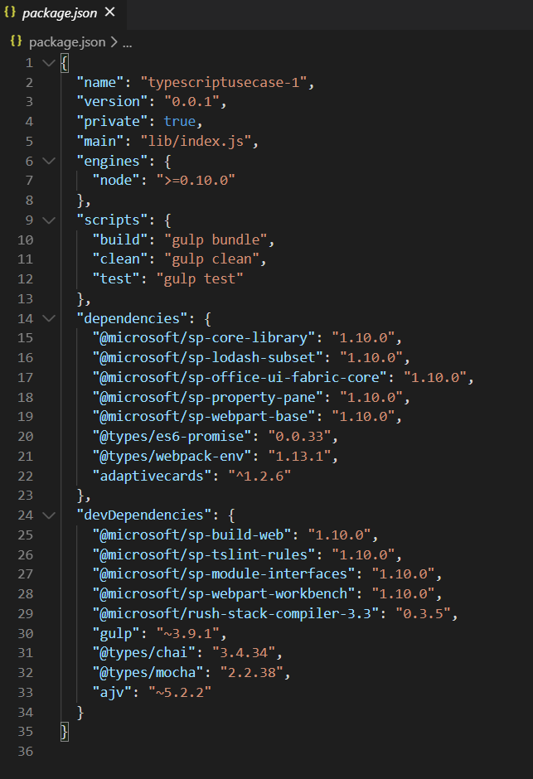
Ensuring dependencies are tracked with package.json
If the --save flag is also specified when adding a package with npm install, an entry is written into the package.json file in the application’s directory. This goes into the “dependencies” section of the file, and will look something like this:

Slide 8
Demo
Lab 8 – Create a Webpart with TypeScript with JSON as Data source

Slide 9
Agenda
Module 6: Client Web Part Properties
Client Web Part Properties
Webpart Properties
Adding Properties
Using Properties
Preconfigured Entries
Dynamic Data
Custom Properties
Advanced Configuration

Slide 10
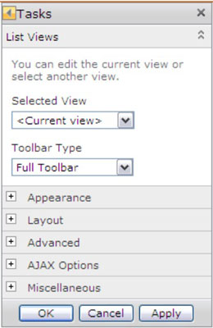
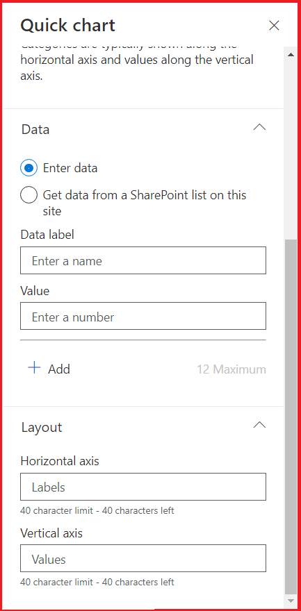
Client Web Part Properties
In classic SharePoint Server web parts can be configured using the properties, generally referred to as WebPart properties. In the SPFx world, they are referred to as property panes. The property panes allow controlling the behavior and appearance of a web part.
The Modern SharePoint Framework have a new WebPart Property pane. The property pane allows end users to configure the web part with a bunch of properties.

Slide 11
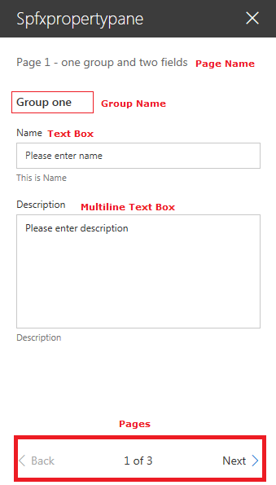
Webpart Configuration
Pages
Pages provide you the flexibility to separate complex interactions and put them into one or more pages. Pages then contain Header and Groups.
Header
Header allows you to define the title of the property pane and Groups let you define the various sections for the property pane through which you want to group your field sets.
Groups
A property pane should contain a page, an optional header, and at least one group. Property fields are then defined inside a group

Slide 12
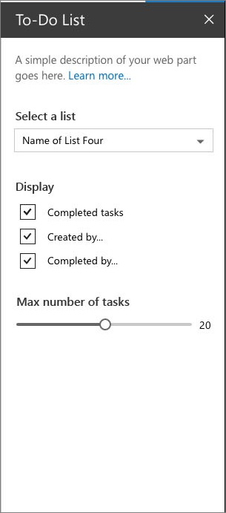
Webpart Properties
The Modern SharePoint Framework have a new WebPart Property pane for WebPart Properties.
The property pane has three key metadata:
Pages
Pages provide you the flexibility to separate complex interactions and put them into one or more pages. Pages then contain Header and Groups.
Header
Header allows you to define the title of the property pane and Groups let you define the various sections for the property pane through which you want to group your field sets.
Groups
A property pane should contain a page, an optional header, and at least one group. Property fields are then defined inside a group

Slide 13
Webpart Properties
Supported Property Fields and Objects
# | Property field | SPFx Typed Object
1 | Label | PropertyPaneLabel
2 | Textbox | PropertyPaneTextField
3 | Multiple lines of text | PropertyPaneTextField
4 | Link | PropertyPaneLink
5 | Dropdown | PropertyPaneDropdown
6 | Checkbox | PropertyPaneCheckbox
7 | Choice | PropertyPaneChoiceGroup
8 | Toggle | PropertyPaneToggle
9 | Slider | PropertyPaneSlider
10 | Button | PropertyPaneButton
11 | Horizontal Rule | PropertyPaneHorizontalRule
12 | Custom | Our own implementation using combination of above
Preconfigured Entries

Slide 14
Webpart Configuration …
Supported Property Fields and Objects
# | Property field | SPFx Typed Object
1 | Label | PropertyPaneLabel
2 | Textbox | PropertyPaneTextField
3 | Multiple lines of text | PropertyPaneTextField
4 | Link | PropertyPaneLink
5 | Dropdown | PropertyPaneDropdown
6 | Checkbox | PropertyPaneCheckbox
7 | Choice | PropertyPaneChoiceGroup
8 | Toggle | PropertyPaneToggle
9 | Slider | PropertyPaneSlider
10 | Button | PropertyPaneButton
11 | Horizontal Rule | PropertyPaneHorizontalRule
12 | Custom | Our own implementation using combination of above

Slide 15
Webpart Configuration …
Property panes allow easy configuration of SPFx client-side web part.
We can use predefined typed objects to create properties for the web part.
Properties can be grouped by pages.

Slide 16
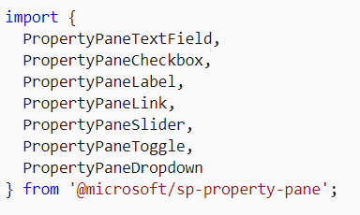
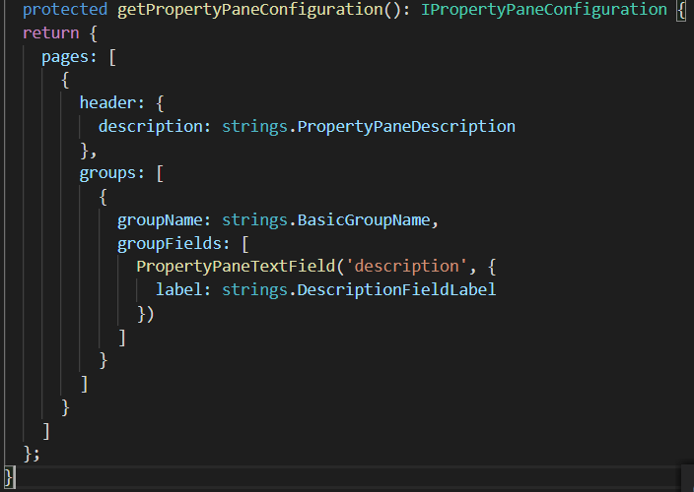
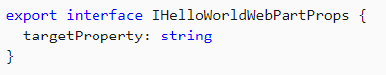
Adding & Using Properties
The field types are available as modules in @microsoft/sp-property-pane. You need to import the objects into a module before you can use them in your web parts.
Note: The property pane objects were split out into their own module, @microsoft/sp-property-pane, in the SharePoint Framework v1.9 release. Prior to this, they were included in the @microsoft/sp-webpart-base module.
Every field type method is defined as follows, taking PropertyPaneTextField as an example →
The targetProperty defines the associated public property on the web part for that field type and is also defined in the props interface in your web part.
To assign types to these properties, define an interface in your web part class that includes one or more target properties.
<p class="${ styles.description }">${escape(this.properties.description)}</p>

Slide 17
Types of property panes
Single pane
Used for simple web parts with a few properties to configure. As the name implies, there is only one single pane without any grouping.
Accordion pane
Contains a group or groups of properties with many options, and where the groups result in a long scrolling list of options.
For example, you might have three groups named Properties, Appearance, and Layout, each with many options.
To make the groups appear as accordions, add a displayGroupsAsAccordion property and set it to true
displayGroupsAsAccordion: true,
If you wish to make the groups initially appear as expanded or collapsed, you can specify the isCollapsed property at the group level and set it to true or false, as desired:
isCollapsed: true,
Steps pane
Group properties in multiple steps or pages. Used when web configuration needs to follow a precise order of steps, or when choices in the first step affect the options that display in next steps.
The property pane will display a Back and Next buttons at the bottom of the pane, along with an indication of how many steps there are, and which step is currently displayed.
By default, the web part will start the property pane on the first page. If you'd like to override this (for example, if you want to bring attention to a specific page to encourage a user to solve an issue), specify the currentPage
currentPage: 3,

Slide 18
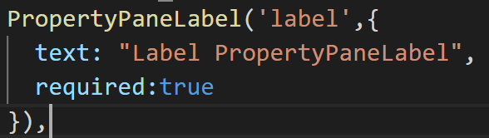
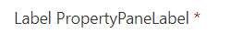
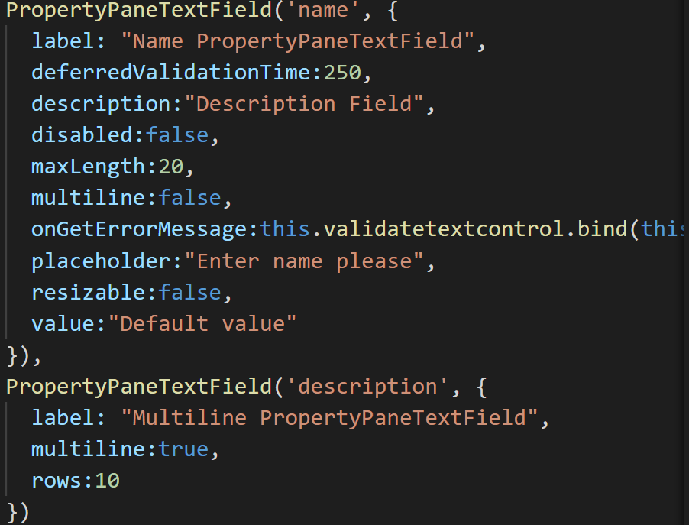
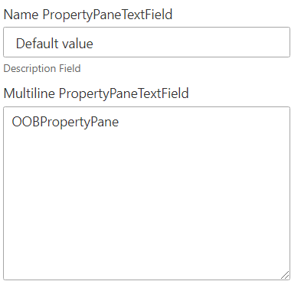
Property Pane

Slide 19
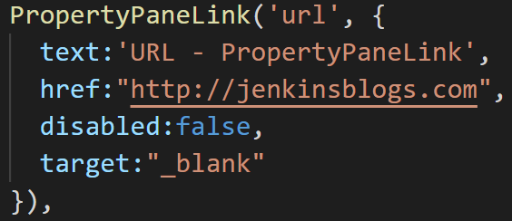

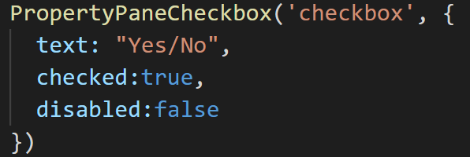

Property Pane

Slide 20
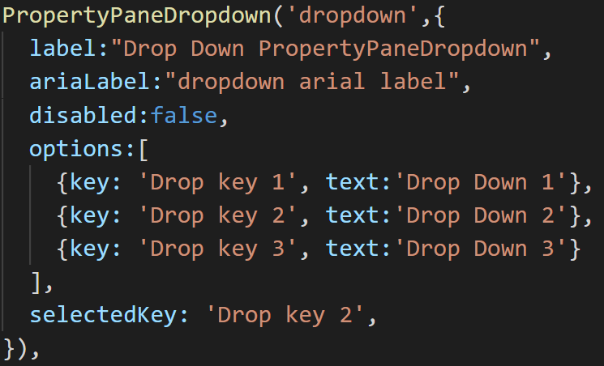
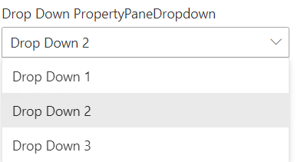
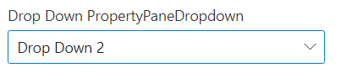
Property Pane

Slide 21
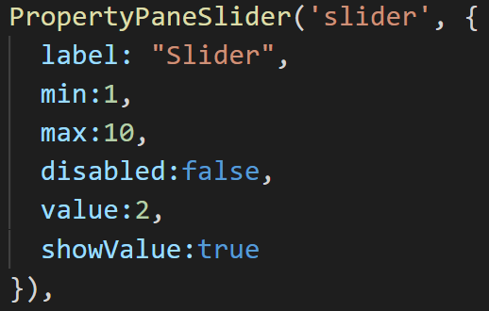
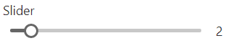
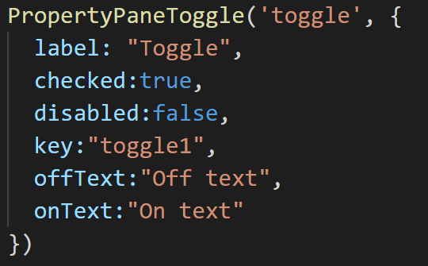
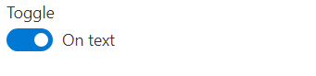
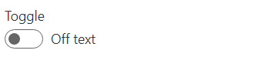
Property Pane

Slide 22
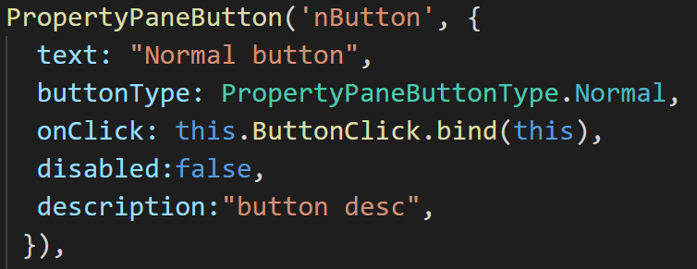

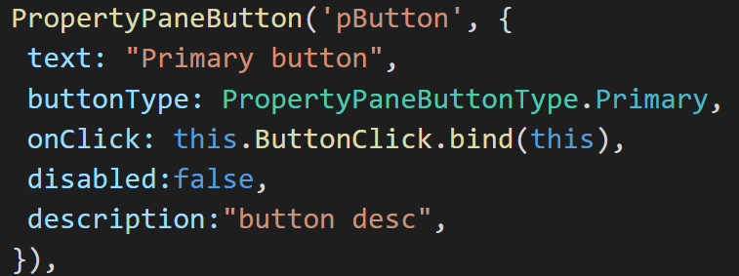

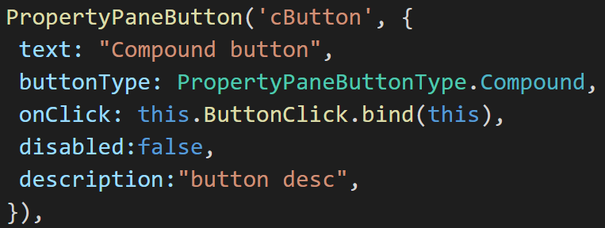
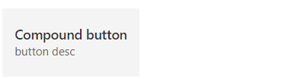
Property Pane

Slide 23
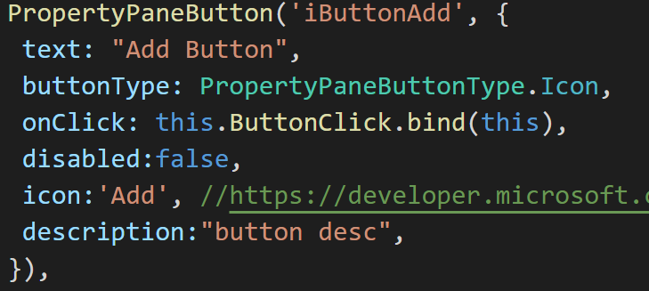
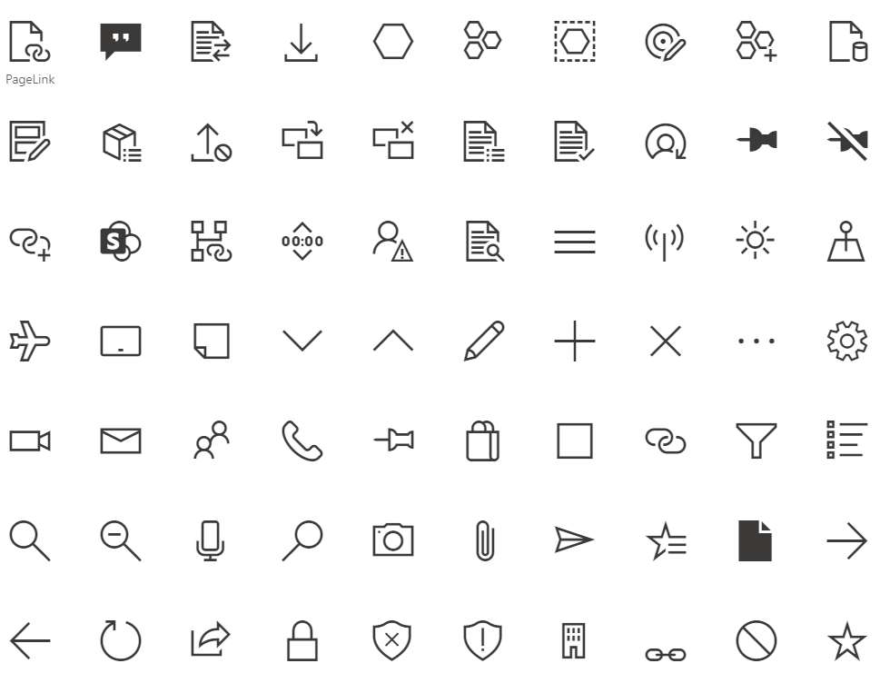

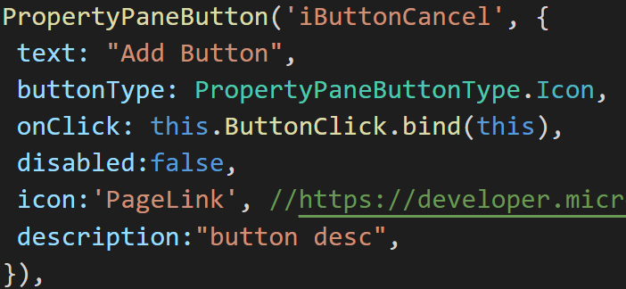
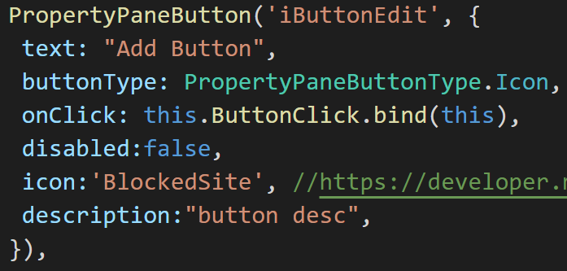
Property Pane
https://developer.microsoft.com/en-us/fluentui#/styles/web/icons

Slide 24
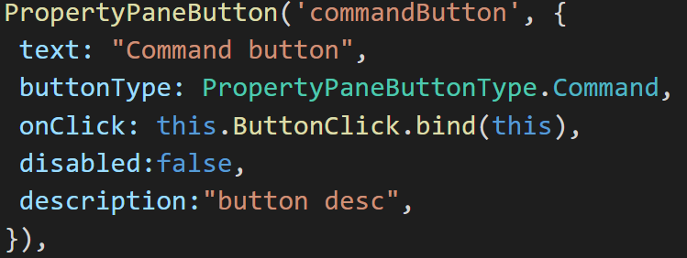

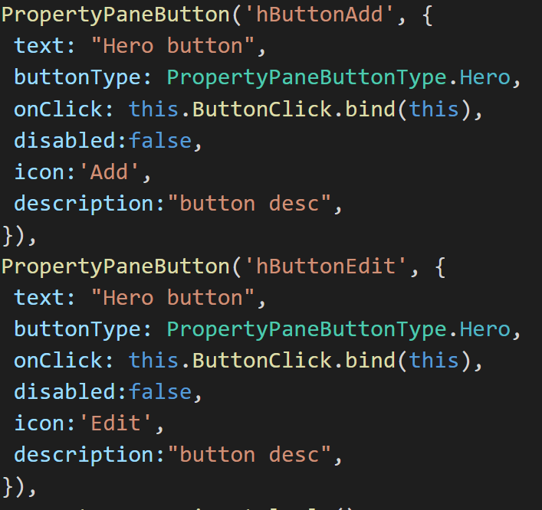

Property Pane

Slide 25
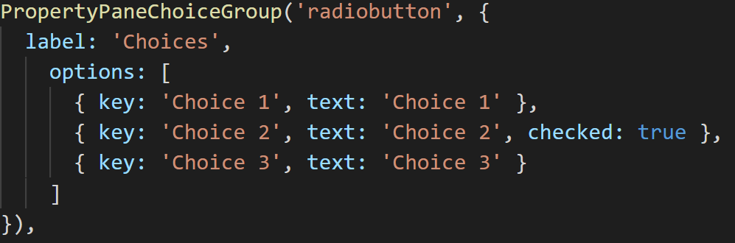
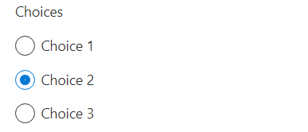
Radio Property Pane

Slide 26
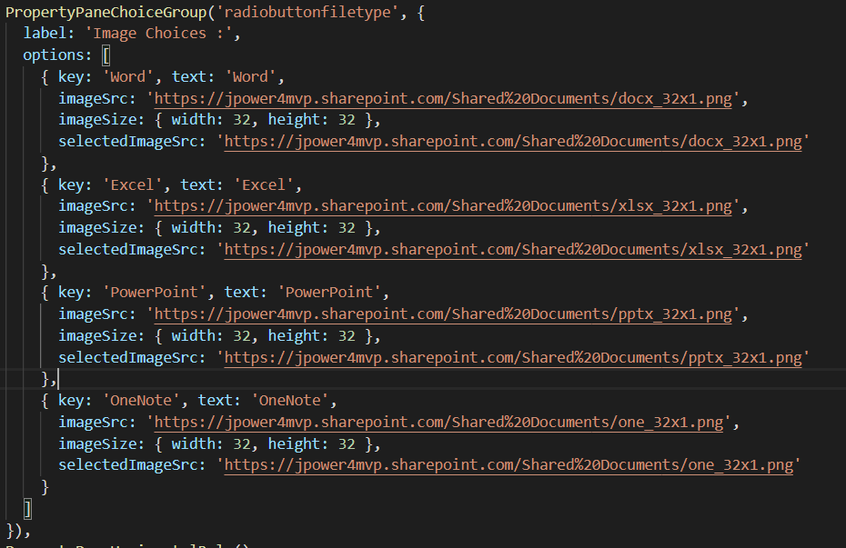
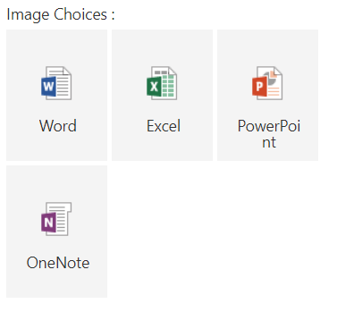
Radio Property Pane

Slide 27
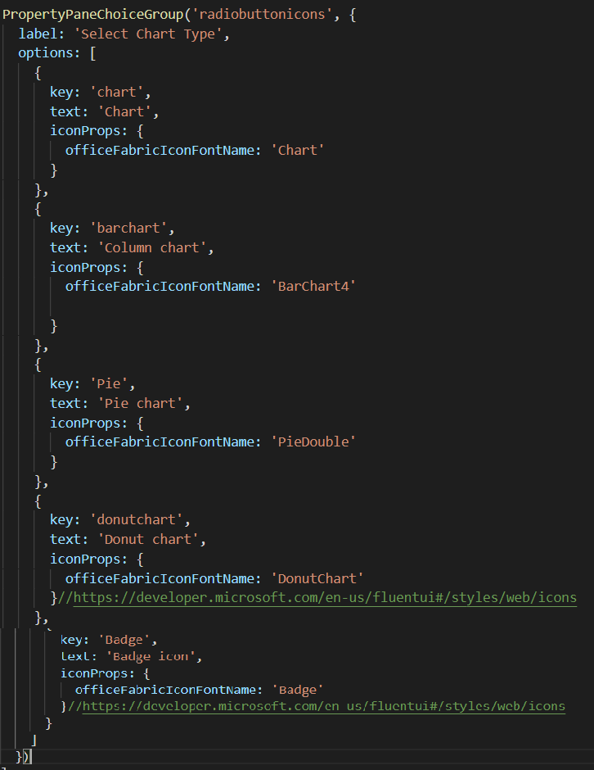
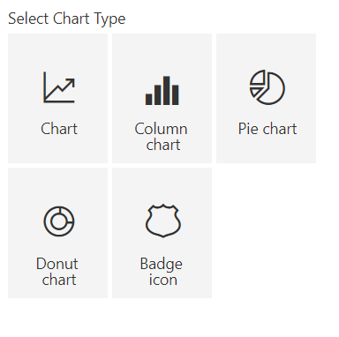
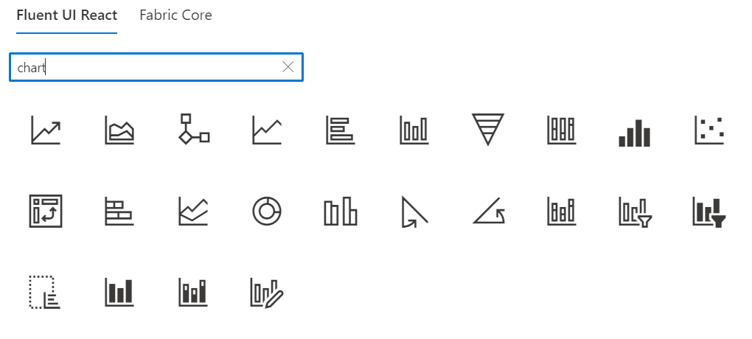
Radio Property Pane
https://developer.microsoft.com/en-us/fluentui#/styles/web/icons

Slide 28
Loading SharePoint Data in a SPFx web part
Page Context
Web Services Overview
SharePoint REST API’s
Using HttpClient
Loading SharePoint data

Slide 29
Page Context
The page context provides standard definitions for common SharePoint objects that need to be shared between the client-side application, web parts, and other components. Typically the data is fetched via REST queries when navigating to a new page, but it can also be preloaded by the web server or filled from a custom application cache.
Provides access to information about current context
Greatly extended version of _spPageContextinfo
Property | Description
aadInfo | If the current page doesn't have an associated Azure Active Directory tenant, this property will be undefined
cultureInfo | It provides culture info for the current user of the application
isInitialized | Returns whether the PageContext has been initialized
list | Contextual information for the SharePoint list that is hosting the page. If there is no list associated to the current page, this property will be undefined
listItem | Contextual information for the SharePoint list item that is hosting the page. If there is no list item associated to the current page, this property will be undefined
site | Contextual information for the SharePoint site collection ("SPSite") that is hosting the page.
user | It provides contextual information for the SharePoint user that is accessing the page. This class is primarily used with the PageContext class.
web | Contextual information for the SharePoint site ("SPWeb") that is hosting the page.

Slide 30
Page Context …
Examples
import { SPPermission } from '@microsoft/sp-page-context’;
this.context.pageContext.web.absoluteUrl
this.context.pageContext.web.permissions.hasAllPermissions(SPPermission.fullMask);
hasAllPermissions : Checks if the user has all the permissions
this.context.pageContext.web.permissions.hasAnyPermissions(SPPermission.manageWeb);
hasAnyPermissions: Checks if the user has any permission from the collection of permissions
this.context.pageContext.web.permissions.hasPermission(SPPermission.viewPages);
has Permission: Checks if the user has given permission

Slide 31
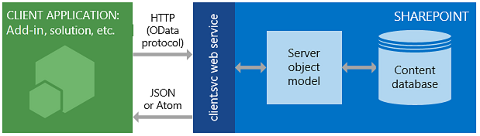
SharePoint REST API’s
SharePoint includes a Representational State Transfer (REST) service that is comparable to the existing SharePoint client object models. Developers can interact remotely with SharePoint data by using any technology that supports REST web requests. This means that developers can perform Create, Read, Update, and Delete (CRUD) operations from their SharePoint Add-ins, solutions, and client applications, using REST web technologies and standard Open Data Protocol (OData) syntax.
To access SharePoint resources using REST, construct a RESTful HTTP request by using the OData standard, which corresponds to the desired client object model API.
https://{site_url}/_api/web
https://{site_url}/_api/site
Example
https://jpower4dev.sharepoint.com/_api/web/lists/GetByTitle('Contactlist')/Items
URL end Points – Some exaples | Description
web/title | Retrieves the title of a list
Lists | Retrieves all lists on a site
lists/getbytitle('listname') | Retrieves a single list's metadata
lists/getbytitle('listname')/items | Retrieves items within a list
lists/getbytitle('listname')?select=Title | Retrieves a specific property of a document

Slide 32
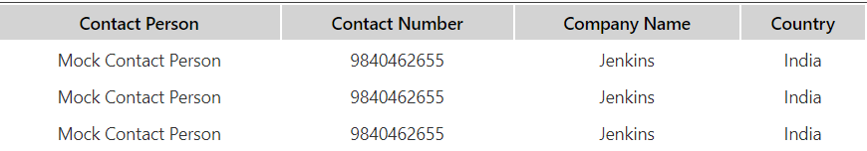
Using HttpClient
HttpClient implements a basic set of features for performing REST operations against a generic service.
import { HttpClient, IHttpClientOptions, HttpClientResponse } from '@microsoft/sp-http’
If you already used the HttpClient and SPHttpClient in your SharePoint Framework projects, you might have noticed that you have two types of request methods options: GET and POST. These two types of requests are the most used ones, but what if you want to use other HTTP methods like PUT, PATCH, DELETE?
If you need to make calls with other HTTP methods, you can make use of the fetch which is available on both the HttpClient and SPHttpClient classes. The fetch method allows you to specify the HTTP method type per request yourself. Fetch is also used behind the scenes when you are using the GET and POST methods.
how you can make use of the fetch method and specifying the request method to perform: spHttpClient
this.props.context.spHttpClient.fetch(restUrl, SPHttpClient.configurations.v1, {
method: "PATCH",
body: JSON.stringify({
"Something": "Some content to patch" })
}).then((response: SPHttpClientResponse) => { // Do your thing});
with the HttpClient, but you will notice that is not that different to use:
this.props.context.httpClient.fetch(restUrl, HttpClient.configurations.v1,
{ method: "DELETE"})
.then((response: HttpClientResponse) => { // Do your thing
});

Slide 33
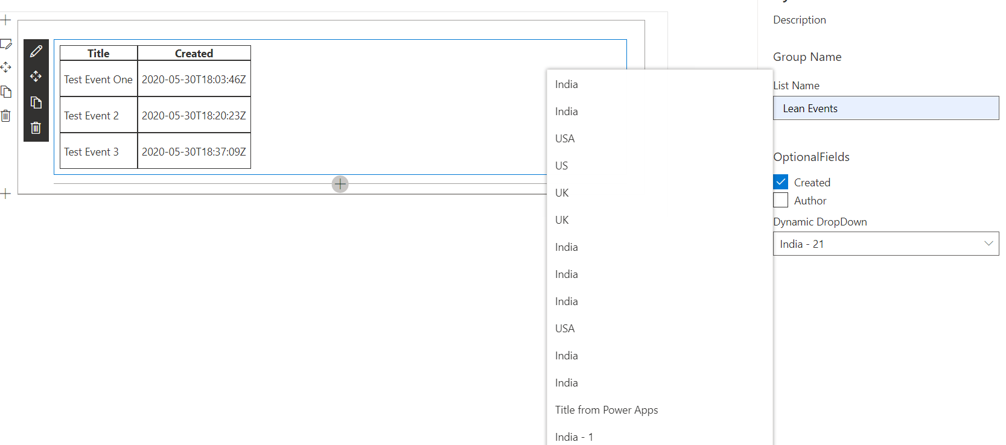
Property Pane Dynamic Data
Using the dynamic data capability, you can connect SharePoint Framework client-side web parts and extensions to each other and exchange information between the components. This allows you to build rich experiences and compelling end-user solutions.

Slide 34
Custom property Pane controls
The SharePoint Framework contains a set of standard controls for the property pane. But sometimes you need additional functionality beyond the basic controls. You might need asynchronous updates to the data on a control or a specific user interface. Build a custom control for the property pane to get the functionality you need.
When we have requirement for custom user experience
More complex to implement than just using out of box stuff
When custom control used, you can get reusability and isolation of the code

Slide 35
What you need to implement for custom control
Property interfaces for configuring the control
Property interfaces for implementing the control
Property Pane
Custom Control
Consumer of Control
Property pane requires IPropertyPaneCustomFieldProps and you want to implement your own property interface for your control
Custom control exposes wanted properties, which can be configured on the control

Slide 36
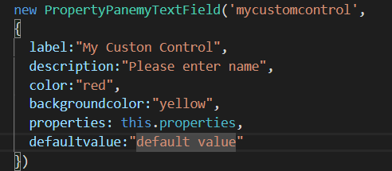
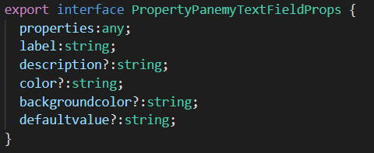
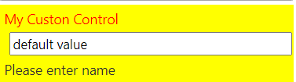
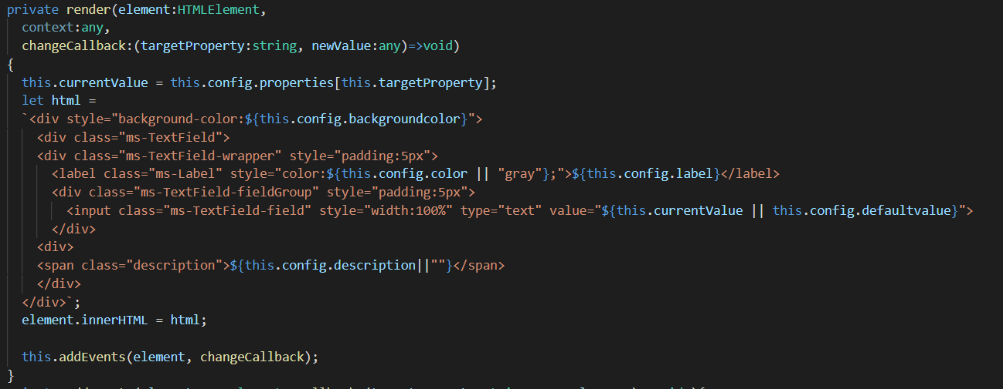
Radio Property Pane

Slide 37
Demo
Lab 9 – Create a Web Part with all Properties
Lab 10 – Radio Button Properties
Lab 11 – Loading SharePoint data
Lab 12 – Custom Properties

Slide 38
References
http://jenkinsblogs.com/2016/08/24/create-a-sharepoint-framework-client-webpart-retrive-list-items/
https://docs.microsoft.com/en-us/sharepoint/dev/spfx/web-parts/get-started/build-a-hello-world-web-part
https://www.youtube.com/channel/UC4JieFHDrN0elIYtZDktZSg
https://www.youtube.com/channel/UC_mKdhw-V6CeCM7gTo_Iy7w

Slide 39



SPFx Info
https://docs.microsoft.com/en-us/sharepoint/dev/spfx/sharepoint-framework-overview
Twitter
@ m365pnp
Tech Community
aka.ms/sppnp-community

